Slide 1
Chronic Kidney Disease-Integration into the NCD Agenda
Professor Tazeen H Jafar
Duke-National University of Singapore & Aga Khan University, Karachi, Pakistan
Notes:
Opening Slide

Slide 2
Overview
  Rising burden of ESRD
  Economic implications
  Earlier Stages and new classification of CKD
  Associated CVD and Reduced Life Expectancy
  Strategies to Prevent
    Evidence on Cost effectiveness of Screening programs
        eGFR reporting
        Albuminuria screening
  Way Forward-Call for Action

Slide 3
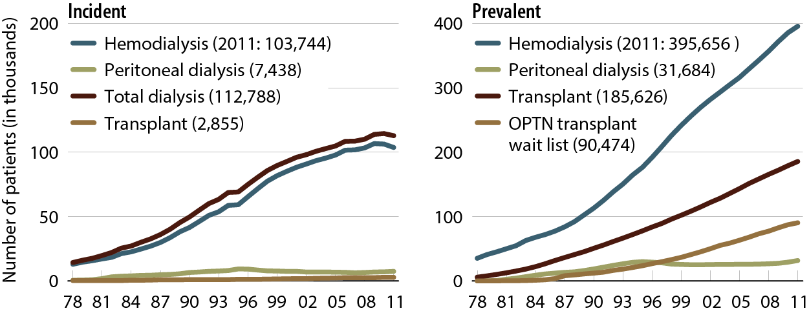
Incident & prevalent patient counts (USRDS), by modality
Incident & December 31 point prevalent ESRD patients; peritoneal dialysis consists of CAPD & CCPD.
Notes:
Over 700,000 on RRT, and about 100,00 new added annually. Mostly receive HD in the US.

Slide 4
Global Prevalence of Dialysis
Over 2 million
    the majority of whom are treated in only ﬁve countries (US, Japan, Germany, Brazil, and Italy)
      that constitute only 12% of world population.
Only 20% (400,000) are treated in about 100 developing countries
Notes:
$80,000 annually per pt on HD, $50,000 annually on peritoneal

Slide 5
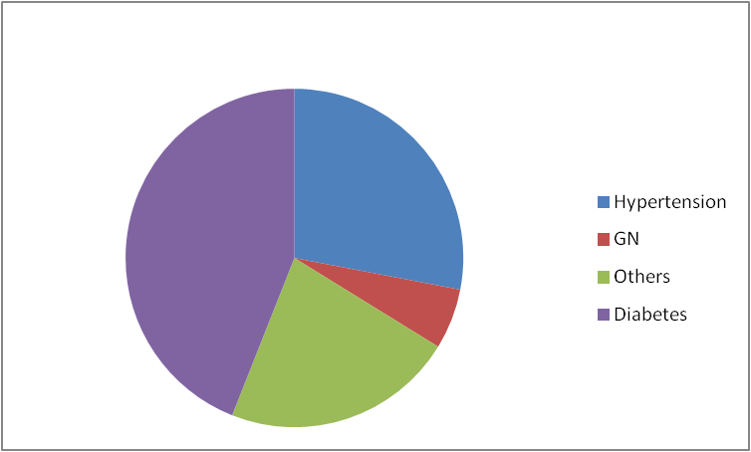
Causes of ESRD Incident Patients
USRDS 2011 Annual Data Report. National Institutes of Health, National Institute of Diabetes and Digestive and Kidney Diseases, Bethesda, MD, 2011.

Slide 6
Cost of ESKD in US
The costs of the ESKD program in the US reached $42 billion in 2009
  $29 billion to Medicare, consuming 6.8% of US Medicare health care budget expenditures.
On a total health care level, ESKD consumes about 2% of total US health care including Medicare and the private insurance system.
USRDS Atlas 2011

Slide 7
CKD Predicts CVD
Age-Standardized Rate of Cardiovascular Events (per 100 person-yr)
Estimated GFR (ml/min/1.73 m2)
Go, et al. Circulation, 2004
Notes:
In fact, not ESRD is just the tip of the iceberg. Earlier stages of CKD with reduction in eGFR are much more common, and they are not benign. Infact, many more people with earlier stages of CKD die of CVD than reach KF. This work by Alan Go shows premature cardiovascular death, not just ESRD, is a major risk for people with CKD. Recent studies have tightened the epidemiological link between CKD and CVD. These studies have reported a graded, inverse relation between initial renal function and subsequent risks of death and complications from cardiovascular disease. Some say, “Only the lucky CKD patients reach ESRD.”

Slide 8
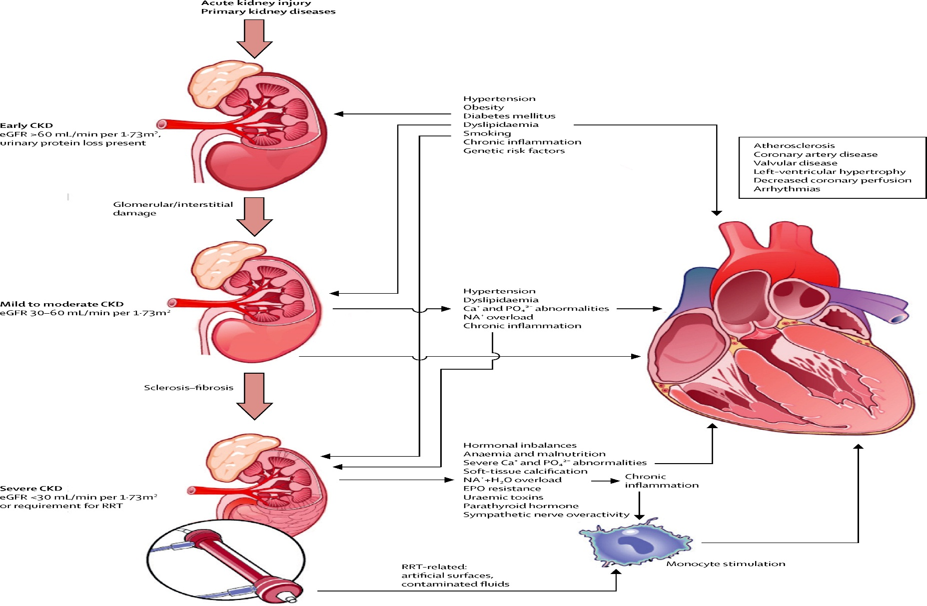
Link Between CKD and CVD
Gansevoort RT et al Lancet 2013
Notes:
Shared risk factors; cause and effect with htn; plus lots others with advanced ckd: oAngiotensin stimu- lates production of superoxide, interleukin 6, and other cytokines. Bioavailability of nitric oxide, which is involved with vascular smooth-muscle contraction and growth, platelet aggregation, and leucocyte adhesion to the endothelium, becomes decreased. Activity of renalase is lowered in individuals with chronic kidney disease. This enzyme is produced by the kidney and inactivates catecholamines.32 All these vasoactive factors impinge on endothelial function. Albuminuria can be interpreted as a sign of, but also as a contributor to, impaired endo- thelial function.32,42 Another key factor for endothelial function seems to be asymmetric dimethylarginine. Concentrations increase with decreasing kidney function

Slide 9
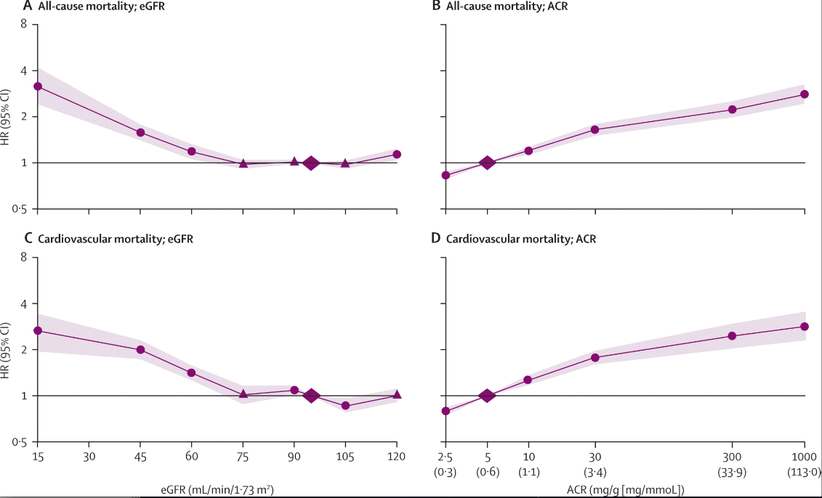
Hazard ratios for CV mortality by eGFR and ACR
. Matushista K et al Lancet 2011

Slide 10
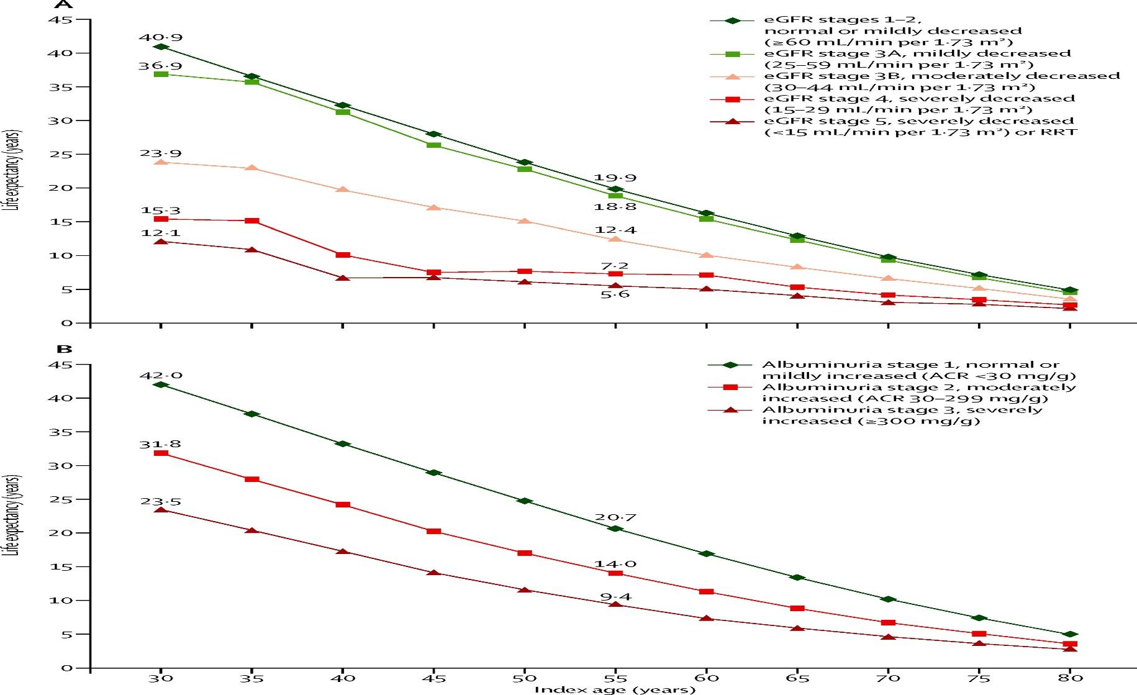
CKD- Markedly Reduces Life Expectancy
Lancet 2013
Notes:
Life expectancy was substantially reduced for patients with impaired kidney function in the Canadian cohort (figure 2). Patients aged 30 years with estimated glomerular filtration rate stage 3B (30–44 mL/min per 1·73 m²) or 4 (15–29 mL/min per 1·73 m²) had reductions in life expectancy of around 17 or 25 years, respectively, compared with individuals with normal kidney function (figure 2). Reductions in life expectancy were also seen among patients with raised albuminuria at age 30 years: stage 2 and 3 albuminuria (30–299 mg/g and 300 mg/g or higher, respectively) were associated with shortening of life expectancy by around 10 and 18 years, respectively, compared with that in individuals without albuminuria (figure 2).

Slide 11
Ann Intern Med. 2013;158(11):825-830.

Slide 12
Prevalence of CKD in Pakistan
Age groups / Disease | Prevalence, % (95% CI)
 | Overall (n=2873) | Men (N= 1374) | Women (N=1499)
Overall (n=2873) CKD Reduced eGFR | 12.5 (11.3 – 13.8) 5.3 (4.5 – 6.2) | 11.6 (9.9 – 13.4) 5.2 (4.1 – 6.5) | 13.3 (11.7 – 15.2) 5.5 (4.4 – 6.7)
40 – 49 yrs (n=1429) CKD Reduced eGFR | 5.9 (4.7 – 7.2) 1.3 (0.7 – 2.0) | 6.2 (4.5 – 8.3) 1.6 (0.8 – 2.9) | 5.6 (4.1 – 7.5) 0.9 (0.4 – 1.9)
50 – 59 yrs (n=755) CKD Reduced eGFR | 14.2 (11.8 – 16.9) 5.3 (3.8 – 7.1) | 11.5 (8.4 – 15.3) 4.9 (3.0 – 7.7) | 16.6 (13.1 – 20.7) 5.6 (3.6 – 8.4)
≥ 60 yrs (n=689) CKD Reduced eGFR | 24.4 (21.2 – 27.8) 13.8 (11.3 – 16.6) | 22.6 (18.2 – 27.5) 12.7 (9.3 – 16.7) | 26.1 (21. 6 – 30.9) 14.8 (11.3 – 19.0)
CKD defined as eGFR <60 ml/min/1.73m2 or ACR 30mg/g or more, CKD 3a A2 or worse

Slide 13
Global Age-Standardized Prevalence of CKD Grade 3-5 and Future Projections Age 20-79 years
unpublished

Slide 14
RENAAL Patients Reaching the Primary Composite Endpoint*
Risk reduction=16%
Placebo
P=0.02
Cumulative % of
patients with event
Losartan
0
12
24
36
48
Months
Placebo† (n)
762
689
554
295
36
Losartan† (n)
751
692
583
329
52
*doubling of serum creatinine, end stage renal disease, death
Brenner BM, et al. N Engl J Med. 2001;345(12):861-869.
Notes:
RENAAL Patients Reaching Primary Composite Endpoint
The primary endpoint for RENAAL was the composite of time to doubling of serum creatinine (SCr), end stage renal disease (ESRD), or death. The doubling of the serum creatinine concentration was defined as the first serum creatinine value that was twice the baseline value, as confirmed by a second serum creatinine value obtained at least four weeks after the initial doubling. End stage renal disease was defined by the need for long-term dialysis or renal transplantation. By an intention-to-treat analysis, the primary analysis approach of the study, losartan resulted in a significant risk reduction of 16% (P=0.02) in the primary composite endpoint.
Reference:
Brenner BM, Cooper ME, de Zeeuw D, Keane WF, Mitch WE, Parving HH, Remuzzi G, Snapinn SM, Zhang Z, Shahinfar S. Effects of losartan on renal and cardiovascular outcomes in patients with type 2 diabetes and nephropathy. N Engl J Med. 2001;345(12):861-869.

Slide 15
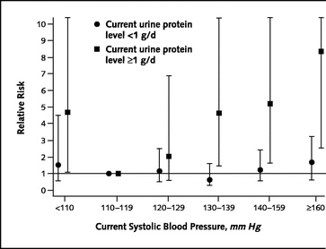
Relative risk for progression of CKD based on current level of SBP and current UP excretion
Jafar et al: Ann Intern Med, Volume 139(4) 2003.244-252

Slide 16
SHARP: Major Atherosclerotic Events
25
Risk ratio 0.83 (0.74 – 0.94)
20
Logrank 2P=0.0022
Placebo
15
Proportion suffering event (%)
Eze/simv
10
5
0
0
1
2
3
4
5
Years of follow-up
Notes:
Sharp trial that cholesterol lowering in pateints with CKD may reduce the risk of CVD

Slide 17
eGFR Reporting
In the US and UK, estimated GFR (eGFR) is reported by more than 75% of clinical laboratories when serum creatinine is measured

Slide 18
GFR Estimation Equations
CKD-EPI Equation (original)
For men and SCR ≤ 0.9: 141 x (SCr/0.9)^{-0.411} x (0.993)^{age}
For men and SCR > 0.9: 141 x (SCr/0.9)^{-1.209} x (0.993)^{age}
For women and SCR ≤ 0.7: 144 x (SCr/0.7)^{-0.329} x (0.993)^{age}
For women and SCR > 0.7: 144 x (SCr/0.7)^{-1.209} x (0.993)^{age}
MDRD Study equation (Original)
GFR = 175 x SCr^{-1.154} x age^{-0.203} If woman: GFR x 0.742
Japanese CKD-EPI Equation = 0.813 x eGFR-EPI
Japanese MDRD Equation = 0.808 x MDRD
Chinese MDRD Equation = 1.233 x MDRD
CKD-EPI_{cr} Pakistan equation 0.686 × CKD-EPI_{cr}^{1.059}

Slide 19
Screening for Estimated GFR
GFR estimation equations
    General population
      Cost effectiveness?
    High Risk population
      Incremental value of screening in addition to albuminuria
        In NHANES III, 20 percent of persons with diabetes, and 43 percent of persons with hypertension and a GFR below 30 mL per minute per 1.73 m2, had no albuminuria. (Garg AX, KI 2002)
        Therefore, an estimate of the GFR (and a screening method for albuminuria) are required (K/DOQI. Am J Kidney Dis 2002;39 (2 suppl 1):S1-266.

Slide 20
Automated eGFR screening
Increased referrals to nephrologists.
Appropriate referrals.
Better planned care

Slide 21
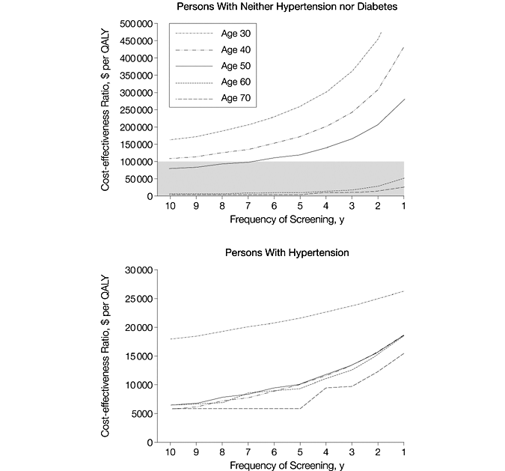
Screening for Proteinuria
Boulware, L. E. et al. JAMA 2003;290:3101-3114.
Notes:
Using the yardstilc of >$50.000/qaly Screening for proteinuria CE in thr elderly, and in pts with htn

Slide 22
Screening for Albuminuria (>30mg/d)
    General population:
      PREVEND Successful in Netherlands- CE when Rx at UEA >50 mg/day <20,000 Euro/LYG (Attohbari et al. Clin Therapeutics 2006)
        Accounted for CVD risk and kidney disease progression
      Needs evaluation in other settings
    High risk population:
      Rx with ACEI in diabetics without screening may be of value (Golan et al. Ann Intern Med. 1999;131:660-7).
      Screening and Rx with ARB $20 011 per QALY gained for screening and optimized treatment versus no screening (Palmer AJ NDT 2008)
      Screening and optimal Rx with RAAS CE in European settings (Palmer AJ, diab Med 2006)
      Needs evaluation in developing countries.
      ACR good screening tool (Jafar T, NDT 2007)
      28% of diabetics and 19% of hypertensive aged 40+ in Pakistan screen positive for MA (Jafar NDT 2009)

Slide 23
CKD Prevention Country Specific Initiatives
Kidney Early Evaluation Program (KEEP) United States (NKF) (selective screening)
Netherlands (mass screening)
Singapore (NKF-S) (mass screening)
Hong Kong (SHARE-mass screening)
Japan (employer) (mass screening)
Bolivia (Mario Negri Institute) mass screening at level-I health facility
Kidney Help Trust (India) (mass screening)

Slide 24
Problems with High Risk Screening for CKD in Developing Countries
High rates of:
Undetected/Unaware Hypertension
    70% in Pakistan
    86 % in rural and 64% in urban China
    81 % in rural India
Undetected/Unaware Diabetes
    50% in Pakistan
    60-70% in China
First step for screening program for CKD would be screening for hypertension and diabetes

Slide 25
Donor funding for NCDs
In 2007 less than 3 percent ($503 million out of $22 billion) of overall donor assistance for health was dedicated to NCDs. (Ravishankar et al., 2009)
Donors provided about $0.78/DALY attributable to NCDs in developing countries in 2007, compared to $23.9/DALY to HIV, TB, and malaria.

Slide 26
Essential to Include CKD in Global NCDs Prevention Agenda
UN High Level meeting prioritizes CVD, cancer, diabetes, respiratory diseases
  25% reduction by 2025
Call to action: reduce prevalence of CKD

Slide 27
Synergies-building global partnerships for CKD Prevention
Powerful Advocacy for Evidence-Based
Recommendations
Training programs and curricula
Public Private Partnership in CKD
WHO
New Technology in CKD
Low cost treatment for CKD
Improve Healthcare
Delivery for CKD integrated with
NCD
Private sector/
donors
ISN/
KDIGO/
societies
CKD Health Promotion
CKD Clinical Registry & Surveillance
Resource Mobilization for CKD

