Slide 1

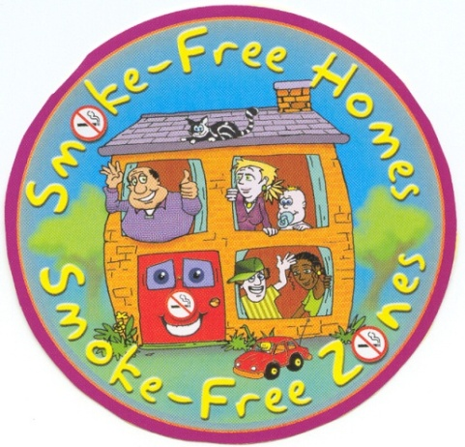
Protecting Children from
Second-hand Smoke
Kamran Siddiqi

Slide 2
My disclosures (funding)
Government
  IDRC, DFID, NHS, NIHR
Research council
  MRC
Charity
  Cancer Research UK
Pharmaceutical
  Not yet
Tobacco industry
  Never

Slide 3
Today’s talk
Problem – children exposed to SHS
Analysis – adult behaviour
Solution – a school-based approach to change adult behaviour

Slide 4



York
‘There is not other city in Britain more capable of illustrating the history of country at large…’

Slide 5
Problem

Slide 6
Problem
600,000 people die each year due to second-hand smoke (SHS) exposure (mostly women and children)
In adults – cancers, TB, cardiovascular and chronic lung diseases (Eisner et al 1998)
In children - chest infections, asthma, reduced lung functions, middle ear infections, sudden infant death syndrome, meningococcal disease in children (Cook and Strachan 1999, Strachan and Cook 1997), poor school performance, behavioural problems, and higher take up of smoking in adolescence
Notes:
SHS is prevalent in practically every region of the world , regularly exposing more than a third of all people to its harmful effects, globally. 600000 people die every year not because they smoke but because of the smoking habits of others. It is contributing to about 1% of the global burden of disease, worldwide. The link between SHS and health risks has long been established. It is known to be one of the major contributors to cancers, TB, cardiovascular and chronic lung diseases in adults. And children who are exposed to SHS suffer from more frequent and long term illness

Slide 7
Problem
 | Children exposed to SHS (%)
Global | 40%
England – White population | 25%
England – Bangladeshis and Pakistanis | 36%
Bangladesh | 40%
Pakistan | 53%

Slide 8
Analysis

Slide 9
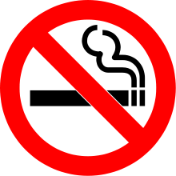
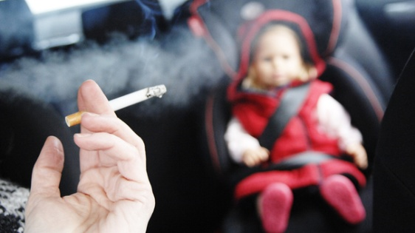
Analysis
Ban on smoking in indoor public places in many countries (in England 2007)
Primary source of SHS exposure – homes & cars
Notes:
There is a tobacco policy to restrict smoking in indoor public places in many European countries. In the UK, the policy came into existence in 2007. This has made a big impact in reducing the social visibility and Since then, more places are going smoke free but there is another side to the story. Homes and cars are not under its jurisdiction. Thus letting an estimated 51% of children in Europe and UK live with at least one smoker in their homes. Moreover, 93% of the world population is still living in countries not covered by 100% smoke-free public health regulations, so a large number of non-smokers are still exposed to second-hand smoke in their homes and other non-restricted spaces. Children and women comprise a particularly vulnerable group

Slide 10
Analysis (Bangladeshis and Pakistanis living in England)
South Asians - high susceptibility to cardiovascular diseases
Higher levels of smoking among Bangladeshi- and Pakistani-origin men compared with national average (Sprotson and Mindell 2004)
SHS exposure also common in Bangladeshi- and Pakistani-households (Alwan et al 2010)
51% households with at least one smoker (Alwan et al)
67% households with a smoker are exposed to second-hand smoke (unpublished results – MCLASS)
Notes:
We live in a culturally diverse world, with migration and health of ethnic minorities becoming increasingly important in the policy arena. In England, significant health inequalities exist among people of South Asian origin, as compared to their white British counterparts. In addition, South Asians have a higher susceptibility to cardiovascular diseases and other risk factors resulting in poor health outcomes among them, so lets’ see whether its also true for smoking and SHS and if they are contributing to the health disparity and higher susceptibility to diseases.
And the answer is yes, In England, 51% of the Asian households have at least one smoker and 67% households with a smoker are exposed to second-hand smoke on cotinine test. There is also some evidence to suggest that SHS is also common in Asian households.

Slide 11
Analysis (Bangladesh)
Findings from the community survey in Bangladesh (Zafarullah et al)
Proportion households with at least one smoker (56%)
Two-third of such households have no restrictions on smoking
Proportion children exposed to SHS (40%)
Notes:
Although children are exposed to SHS exposure in other places, the primary source of SHS exposure is in their homes.
Globally, about 40% of children younger than 14 years of age are exposed to SHS within their homes.
There is a high proportion of people exposed to second-hand smoke in the country (about 42 million). In Bangladesh, second-hand smoke (SHS) is recognised as a principle source of indoor air pollution and a major public health concern. A recent community survey of 722 households in Bangladesh revealed that smoking indoors was a common practice, with more than half (55.5%) of the households having at least one smoker. A majority of these smokers did not practice smoking restrictions at home (including smoking in front of children), exposing almost 40% of the children to SHS.

Slide 12
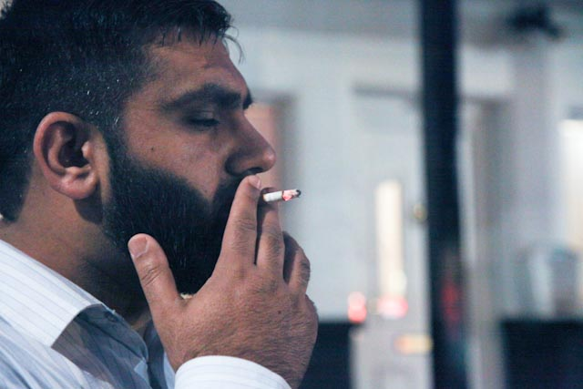
Analysis (Pakistan)
58% households with at least one smoker (Siddiqi et al.)
91% such households - smoking takes place in front of children (Siddiqi et al.)
53% children exposed to SHS
Notes:
Lets see what’s happening in Pakistan! The situation is even worse. On top of other typical third world country problems, we far ahead of many other countries. We’ve got High smoking prevalence and more households with at least one smoker. In 91% of such households, smoking takes place in front of children.

Slide 13
Solution

Slide 14
Voluntary smoking restrictions works!
Households with smoking restrictions
Reduce children’s exposure to SHS (Ronchetti et al 1994)
Help smokers to quit and maintain abstinence (Thomson et al 2005)
Prevent smoking uptake in youth (Warren et al 2006, Farkas et al 2000)
Notes:
For many people the effects of second hand smoke can be prevented. Smoking restrictions at homes and cars are considered as effective means for reducing SHS exposure. Smokers with household smoking restrictions are more likely to attempt to quit and less likely to relapse after quit attempt. Similarly Young people in households with smoking restrictions are less likely to start smoking .
Majority of us already know that, so what’s the solution?

Slide 15
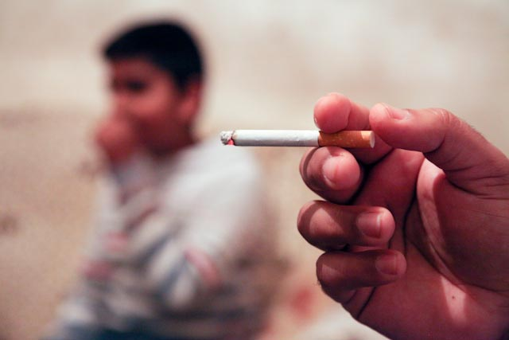
Smoke Free Homes - Aim
To reduce the exposure of non-smokers to SHS in their homes by encouraging families to implement voluntary smoking restrictions
Notes:
One potential solution (that we came up with) is the ‘Smoke Free Homes’ (SFH). Personally, I find the slogan very catchy.
SFH is a UK-based programme aimed at encouraging families to implement smoking restrictions in their homes and cars thereby protecting non-smokers from the harms of SHS.

Slide 16

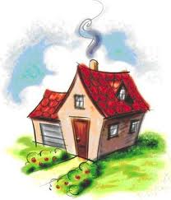

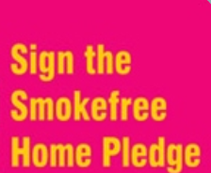

What is Smoke Free Home (SFH)?
Modalities
Target
Output
Notes:
Under the umbrella of smoke free homes, we proposed to test the effectiveness of SFH education delivered to the households through one of the three modalities. And these are the mosques, schools and health care workers. The expected outcome is households taking the smoke free home pledge in order to protect children and non-smoking residents from SHS.

Slide 17
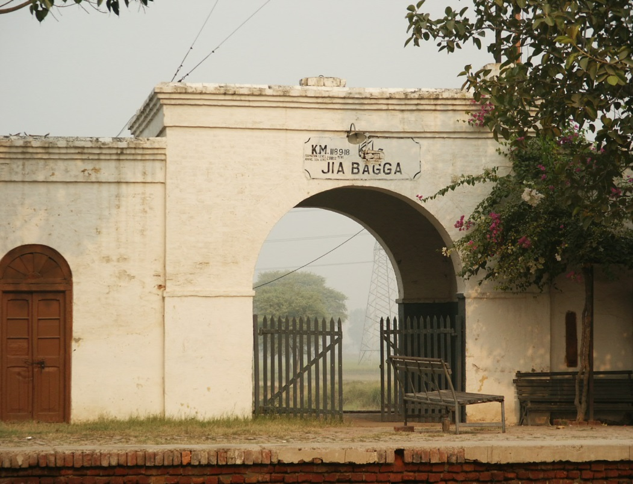
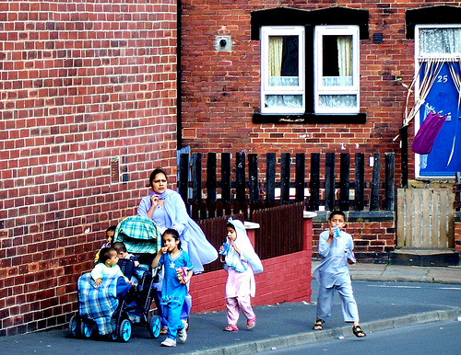
Pilot work
Jia bagga, Pakistan
Beeston hill, England
Notes:
We did some exploratory work in Jia Bagga and Beeston hill, in Pakistan and England, respectively. Jia Bagga is the largest village in Lahore District with approximately 5000 households. It was selected due to its proximity to Lahore (where our researchers were based) and due to its demographics and socio-economic parameters, which were typical of those of rural Pakistan according to the last population census. Similarly Beeston hill Leeds is home to the sizable proportion of Asian community and one of the socio-economically deprived areas in the north of England.
A mix of quantitative and qualitative methods were used. Both the studies had a pre, post-intervention household survey design.

Slide 18
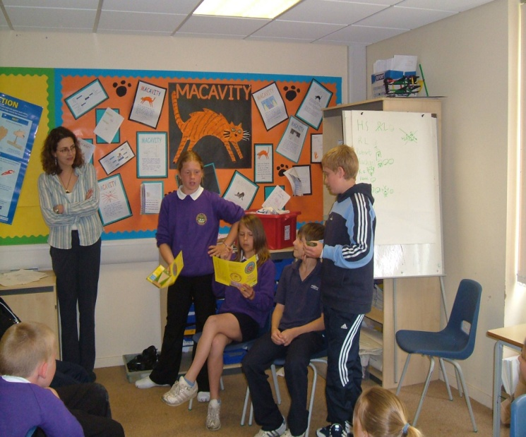
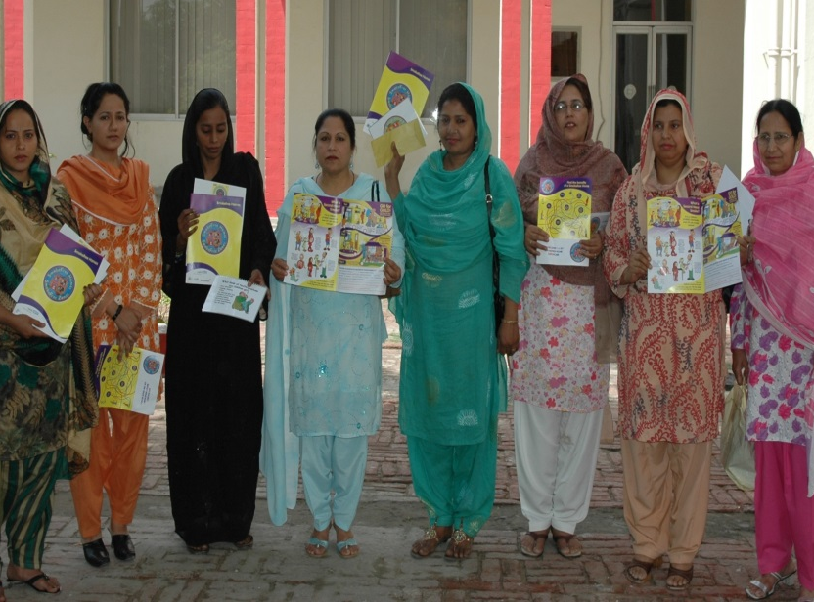
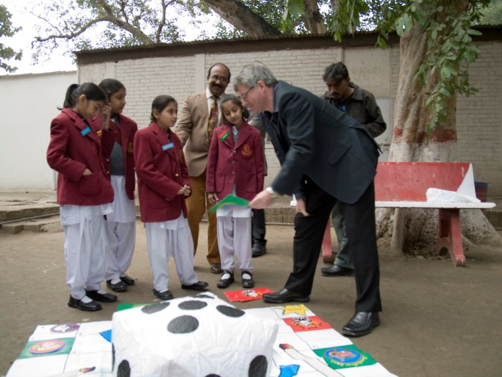
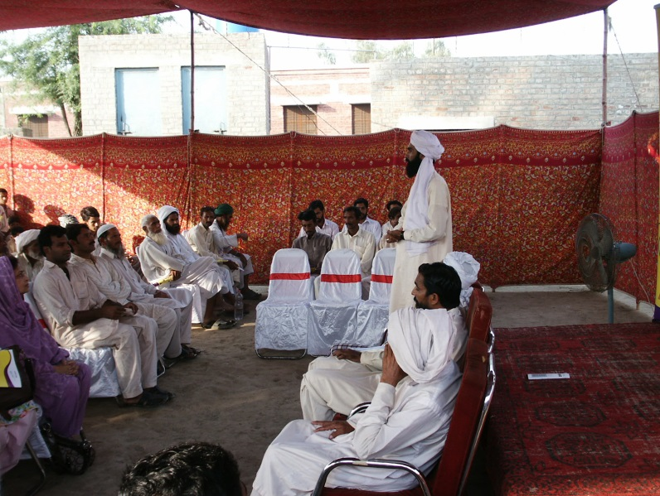
Activities
Notes:
Here comes the most interesting part. In this picture, the students are doing a role play to demonstrate the harms of second hand smoke.
Ok! Can you spot someone from the audience! He looks happy playing snakes and ladders with children.
The Lady health workers helped revise the resource and used it in one to one interviews with female participants.
Imam is explaining about second hand smoking and Islam’s perspective on harming others.
The SFH education focussed on three main themes; Harmful effect of second hand smoke, benefits of a smoke free home and a Stepped approach to change people’s behaviours towards smoking.

Slide 19
Findings
Proportion of Households with at least one regular smoker
Group | Proportion of households (n/N) | 95% CI
England
Pre-SFH | 54% (173/310) | 49-60%
Post-SFH | 48% (105/217) | 42-55%
Pakistan
Pre-SFH | 58% (184/320) | 52-63%
Post-SFH | 38% (108/281) | 33-44%
Notes:
And this is what we found.
The results were promising! Approximately, 6% and 20% reduction in the proportion of households with at least one smoker, in England and Pakistan, respectively

Slide 20
Findings
Proportion of households with smoker (s) where smoking takes place in front of children
Group | Proportion of households (n/N) | 95% CI
England
Pre-SFH | 42% (73/173) | 35-50%
Post-SFH | 20% (21/105) | 13-29%
Pakistan
Pre-SFH | 91% (167/184) | 87-95%
Post-SFH | 0 (0/108) | 0
Notes:
And in England, a 20% reduction in the proportion of households with at lease one smoker where smoking takes place in front of children.
Pakistan seems to have done a really good job with 100% reduction.

Slide 21
Children Learning About Second-hand Smoke (CLASS) in Bangladesh –
A cluster-randomised trial
Rumana Huque, University of Dhaka, Bangladesh
Heather Thomson, Ian Cameron – Leeds City Council, UK
Omara Dogar, Kamran Siddiqi- University of York, UK
Funding – NHS Leeds

Slide 22
Aims & Objectives
Aim - to reduce children’s exposure to second hand smoke in their homes
Objectives
To develop a school based intervention to enable children as agents of adult behaviour change;
To test the feasibility of the intervention; and
To assess its effectiveness in reducing SHS exposure
Notes:
Our aim is to reduce children’s exposure to SHS in their homes. The salient objectives of CLASS Bangladesh study are; (i) to develop a school based intervention to enable children as agents of behaviour change; (ii) to pilot test the developed intervention; and (iii) to test its effectiveness and cost effectiveness in reducing SHS.

Slide 23
Intervention

Slide 24
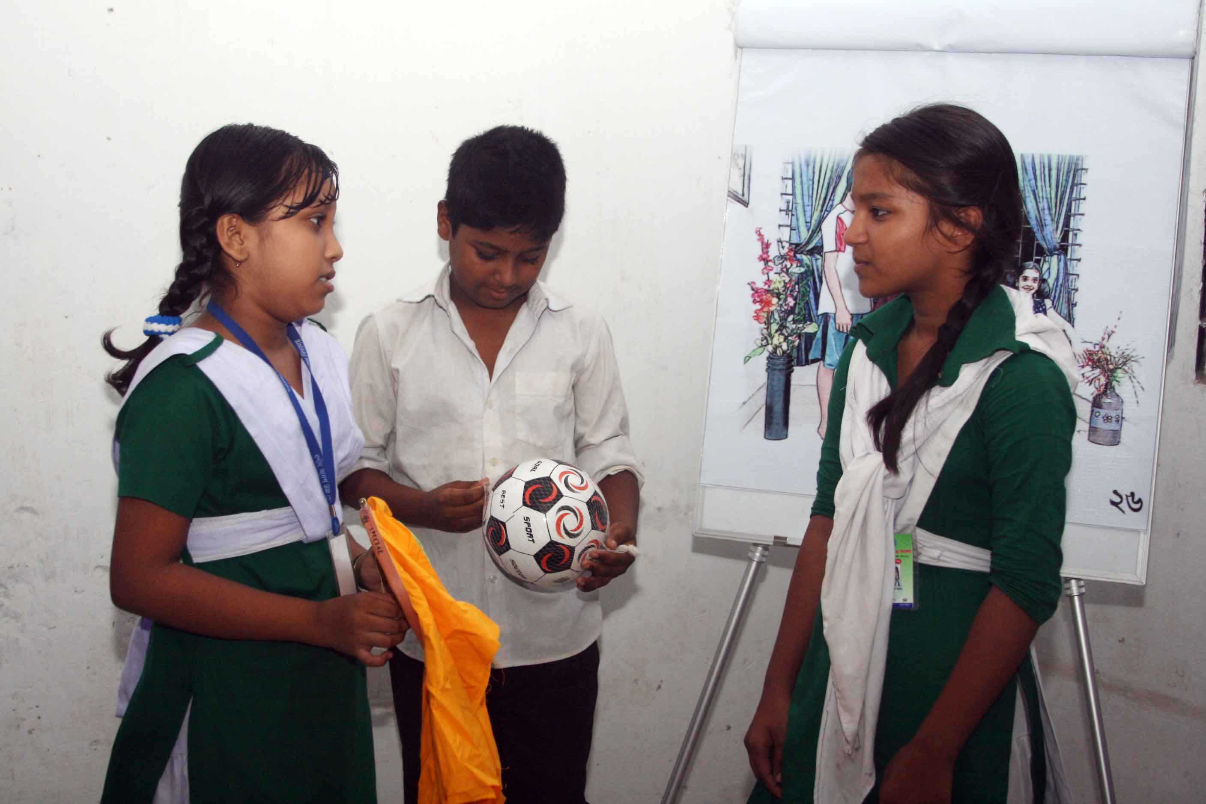
Development
A technical working group FGDs & Observations
Notes:
In the development sub-phase, we convened a “technical working group” of national experts in second-hand smoke control, and behaviour change experts. This group, using the findings of the FGDs and direct observations developed the relevant communication materials and a process for delivering the intervention.

Slide 25
Stage 1: Teacher to child
S1 DISTAL OUTCOMES
Children go home and instigate discussion about smoking behaviour
Children always leave the room if someone is smoking
Notes:
Empowering children to act as advocates of changing smoking related behaviour of parents or other smokers living at home

Slide 26
Stage 2: Child to parent
Children go home and instigate discussion about smoking behaviour
Children always leave the room if someone is smoking
Notes:
The intervention is designed to encourage families to implement smoking restrictions in their homes and reduce their exposure to SHS.

Slide 27
Methods

Slide 28
Research design
A Cluster Randomised controlled trial
Notes:
So before doing a Cluster randomised controlled trial to evaluate the effect of a smoke-free intervention on reducing children's’ exposure to second hand tobacco smoke in their homes in Dhaka, Bangladesh, we needed to pilot test it

Slide 29

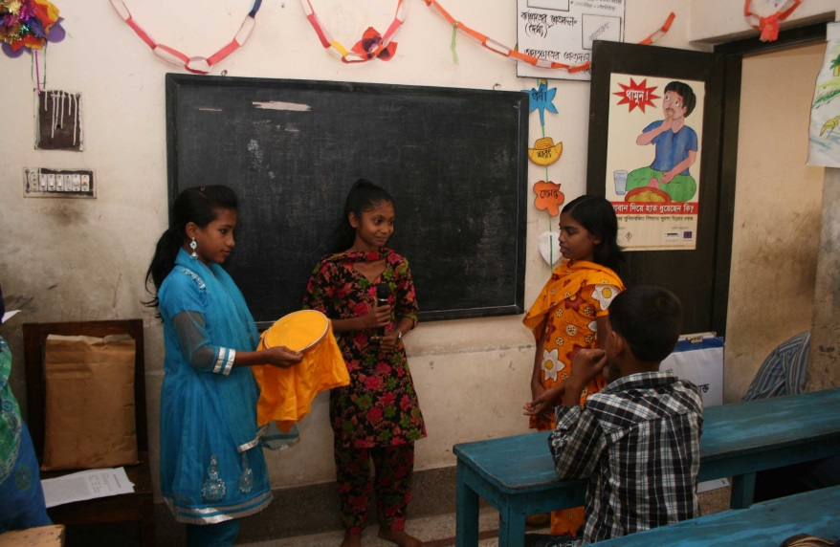
Settings and Participants
Dhaka
The study was conducted in 24 primary schools in Dhaka, Bangladesh.
A primary school
Inclusion criterion
Year five students, 9 to 11 years of age
Schools having at least 10 students and not more than 60 students in the class
Notes:
The study was conducted in primary schools in Dhaka, Bangladesh that had at least 10 and not more than 60 students in fifth class

Slide 30
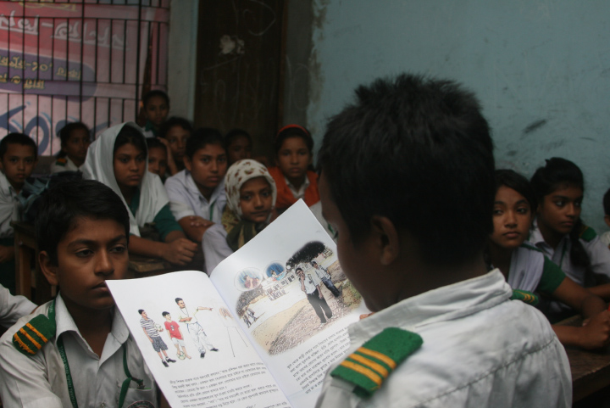
Allocation to intervention
Eight schools each were randomly allocated to three groups:
Arm A: Smoke-free intervention only
Arm B: Smoke-free intervention plus refresher sessions
Arm C: Controls
Notes:
Arm A: schools received teacher’s training session (half-day), and two school-based activities for students (45 minutes each, delivered over two days)
Arm B: received the above and another four school-based refresher sessions (15 minutes each, delivered in subsequent weeks)
Arm C: received no intervention

Slide 31
Outcomes
Primary outcome
Self-reported smoking restrictions
Visibility (smoking) in homes
Assessment
Student surveys at baseline, weeks 1, 12, 27 & 52
Notes:
Smoking restriction: for the purpose of this study is defined as, reporting smoking exclusively outside the home.
Social visibility: this was measured through the reported smoking in front of children at home.
The primary outcome measure is self-reported smoking restrictions and visibility in homes. Secondary outcomes included a reduction in households with at least one smoker.
This was assessed through students’ surveys repeated at the end of week 1 (post-intervention in Arm A), week 12 (post-intervention in Arm B), week 27 and week 52.

Slide 32
Findings

Slide 33
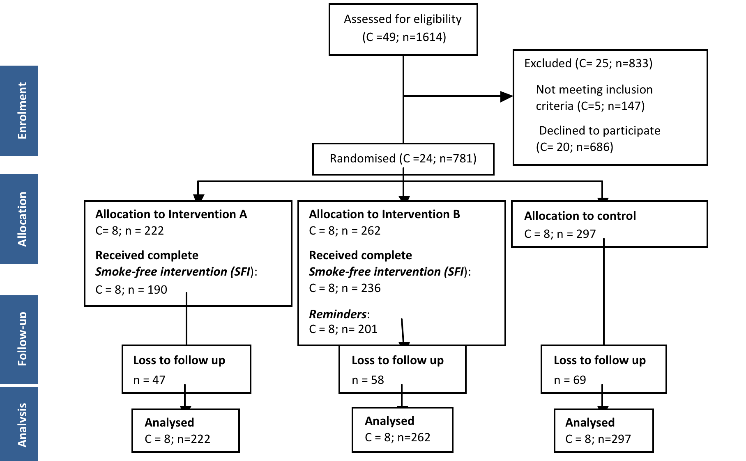
Flow diagram
Notes:
A total of 781 participants were enrolled in the 24 schools, out of which 174 were lost to follow-up at 1 year; main reason being absence from school on the day of evaluation. The loss to follow up was non-differential across the three arms.

Slide 34
Baseline characteristics
Cluster level characteristics | Arm A N= 8, n=222 Mean (SD) | Arm B N=8, n=262 Mean (SD) | Control N=8, n=297 Mean (SD)
Age, y | 12.3 (0.49) | 12.2 (0.42) | 12.4 (0.42)
Males, n | 11.7 (3.1) | 14.2 (9.5) | 23.2 (7.6)
Open space outside home, n | 16.5 (8.3) | 15.5 (6.0) | 14.1 (4.3)
Someone smokes at home, n | 9.9 (7.2) | 6.5 (4.1) | 12.8 (11.5)
Percentage of Adult smokers in a household, n | 16 (0.09) | 9 (0.07) | 15 (0.11)
Residents smoke indoors, n | 4.5 (4.5) | 3.1 (2.9) | 7.7 (6.8)
Visitor’s smoke indoors, n | 3.4 (2.3) | 3.1 (2.8) | 7.2 (6.1)
Residents smoke in front of child, n | 2.6 (2.7) | 1.6(1.7) | 7.2 (6.5)
Visitor smoke in front of child, n | 2.8 (2.5) | 1.5 (1.5) | 6.5 (5.8)
Smoke-Free Home, n | 21.9 (6.4) | 28.0 (11.9) | 22.7 (6.5)
Social visibility, n | 3.5 (3.0) | 2.0 (2.2) | 8.0 (7.7)
Notes:
The three trial arms were not well-balanced with respect to the baseline characteristics of the individuals summarised at the level of the cluster, showing slight differences across the three groups. The number of male participants and the number of households with at least one smoker living at home, per cluster, were higher on average in the control arm. The indicators measuring smoking restrictions and social visibility at homes were also found to be higher on average in occurrences in the control group. The primary outcome, number of households that were ‘smoke-free’ per cluster was higher on average at baseline in the Arm B as compared to the Arm A and control. The primary outcome, number of households with smokers smoking in front of children, per cluster, was also higher on average in the control arm, at baseline.
†Adult smokers/ total adults living in the household and non-smokers were re-coded as zero
*average per arm, of the mean of characteristic per cluster (for continuous characteristic)
** average per arm, of the number of characteristic per cluster (for dichotomous characteristic)

Slide 35
Primary outcomes
Trial Arm | Participant households n/N (%) | Odds ratio (95% CI) † | P-value | ICC ‡
Smoke-free homes (at 1 year)
Arm A | 148/175 (84.6) | 1.80 (1.08-3.00) | <·0001 | 0.198
Arm B | 182/204 (89.2) | 2.74 (1.60-4.70) | <·0001
Control | 172/228 (75.4) | 1 | -
Social visibility (at 1 year)
Arm A | 15/175 (8.96) | 0.34 (0.19- 0.63) | <·0001 | 0·378
Arm B | 11/204 (5.4) | 0.20 (0.10- 0.39) | <·0001
Control | 49/228 (21.5) | 1 | -
† Generalised estimating equations in SAS 9.3 were used to derive the estimates and ICCs ‡ Intra-cluster correlation coefficient
Notes:
SFH: The odds of having homes smoke-free in Arm A and Arm B were almost twice the odds of having homes smoke-free in the control group at 1 year, and were statistically significant.
Social visibility: The odds of smoking in front of children in the households in Arm A and Arm B were, 2 and 5 times less compared to the odds of smoking in front of children in the households in control group, at 1 year.
The ICC of 0.378 means that 37.8% of the unexplained variation in Social visibility is at the school level, the presence of this large clustering effect indicates a strong influence of the schools in determining the success of the intervention.

Slide 36
Outcomes
Smoke-free homes (SFH) over time, by trial groups
Notes:
These graphs show the number of homes made smoke-free over time for the total households and the sub-group of households with at least one smoker living in it. If the smoke-free intervention has an effect, we would expect the trends to increase with increasing time for both interventions, while remaining constant for the control group.
Now lets have a look at what happened in reality.
Overall, there is a hump in homes made smoke-free at week 1 (which is the post-intervention Arm A survey point) for Arm A and then the effect appears to decrease and become more constant over the next 51 weeks; the Arm B’s effect remains more constant over time and the number of smoke-free homes in the control arm seem to decrease with time.
In the households with at least one smoker, the number of homes made smoke-free increase significantly (from about 30 to 80) at week 1 and then decline to sustain them at 50. Again, the Arm B’s effect remains more constant over time and the number of smoke-free homes in the control arm seem to decrease with time.
The hump of SFHs in Arm A is reflection in the non-smoking households as well. Overall the trends of SFH for the intervention arms increased with time while that for the control group remained almost constant in this sub-group.

Slide 37
Outcomes
Social visibility over time, by trial groups
Notes:
These graphs show the number of homes with smokers smoking in front of children over time for the total households and the sub-group of households with at least one smoker living in it. If the smoke-free intervention has an effect, we would expect the trends to decrease with increasing time for both interventions, while remaining constant for the control group.
Now lets have a look at what's happening here.
Overall, there is a hump in the number of homes with smokers smoking in front of children at week 1 (which is the post-intervention Arm A survey point) for Arm A and then the effect appears to increase and become stable over the next 51 weeks; the number of homes with smokers smoking in front of children in Arm B reduce constantly till week 12 (which is post-intervention Arm B assessment point) and than becomes stable and the trends in control group remain more constant over time.
In the households with at least one smoker, the number of homes with smokers smoking in front of children shows a sigmoid patter for Arm A, with a remarkable dip at week 1. The number then starts to rise until week 27 and then decline again (a pattern that could not be explained). Again, the Arm B’s effect declines till week 12 and then sustains its effect. Interestingly, the control arm seemed to be constant until week 27 and then the number of homes with smokers smoking in front of children starts to increase with time.
Overall the trends of both intervention arms declined constantly till week 12 and remained constant thereafter while that for the control group remained almost constant in this sub-group.

Slide 38
Discussion
Likely that the Smoke Free Intervention (lessons, small group work, games) works
Increase in smoke free households
Decrease in social visibility
The addition of the reminders is beneficial
Schools-based intervention is a useful approach
Children can be a change agent for positively influencing family behaviour
Notes:
The findings of ClASS pilot trial suggest that the school-based smoke-free intervention is likely to work, as both intervention arms showed sustained increase in homes made smoke-free and reduction in social visibility compared to the control group, after 1 year.
However, this is a pilot trial, and the estimates are not adjusted for any factors, nor is it powered to show effectiveness. A bigger trial powered to show the effectiveness of the smoke-free intervention will be the way forward for definitive effect estimates.
Remember, from the baseline characteristics? There were differences between the three arms. As this is a cluster randomised trial these differences mean more than individual level differences between the arms. The strategy that can be used to overcome this issue and make sure the randomisation remains intact in the definitive trial is to stratify randomisation by these identified variables.
We also did not look into the adverse events arising due to the intervention or its impact on the child-parent interactions at home. Which would be a recommended piece of qualitative research to be conducted in future.

Slide 39
Discussion
Base-line imbalances between groups (strategies)
Potential adverse consequences of the intervention

Slide 40
Conclusions
Preliminary findings suggest that the school-based Smoke Free Homes intervention was successful in implementing smoking restrictions and reducing smoking visibility at homes

Slide 41
Today’s talk
Problem – children exposed to SHS
Analysis – adult behaviour
Solution – a school-based approach to change adult behaviour

